Slide 1


Preconditioning Sparse Matrices with Alternating
and Multiplicative Operator Splittings^{[1]}
Qitong Zhao, Jinpai Zhao

Slide 2

Part I: Theory & Construction
‹#› | APMA 4302 Final Project

Slide 3

Our Common Goal: Try to Solve Ax = b
(A is an n x n matrix, b is an n x 1 vector)
‹#› | APMA 4302 Final Project

Slide 4

Try to Reduce the Operational Cost
‹#› | APMA 4302 Final Project

Slide 5

Outer Solver: GMRES
‹#› | APMA 4302 Final Project

Slide 6

‹#› | APMA 4302 Final Project

Slide 7

‹#› | APMA 4302 Final Project

Slide 8
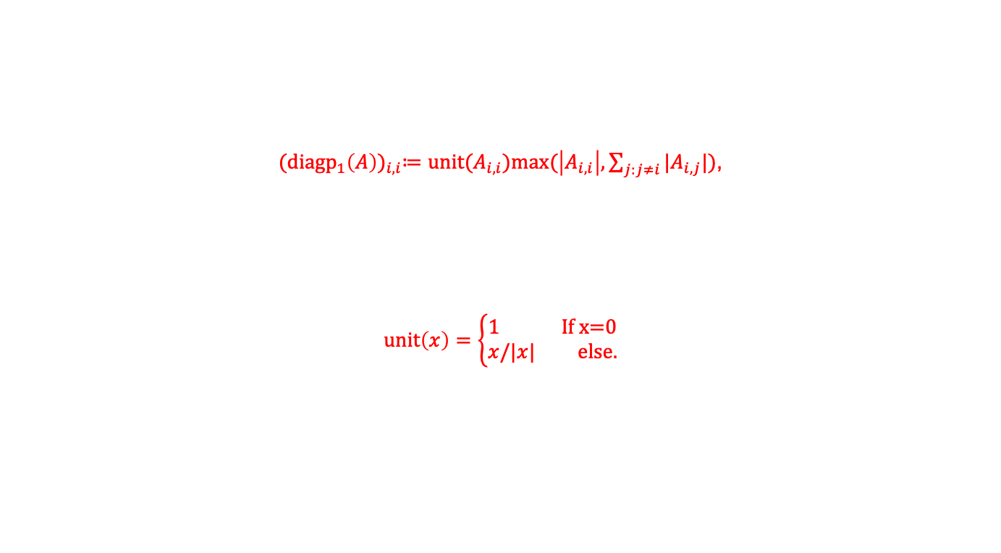
‹#› | APMA 4302 Final Project

Slide 9

‹#› | APMA 4302 Final Project

Slide 10

‹#› | APMA 4302 Final Project

Slide 11

‹#› | APMA 4302 Final Project

Slide 12

‹#› | APMA 4302 Final Project

Slide 13

‹#› | APMA 4302 Final Project

Slide 14

‹#› | APMA 4302 Final Project

Slide 15

‹#› | APMA 4302 Final Project

Slide 16
Part II: Solver & Result
‹#› | APMA 4302 Final Project

Slide 17
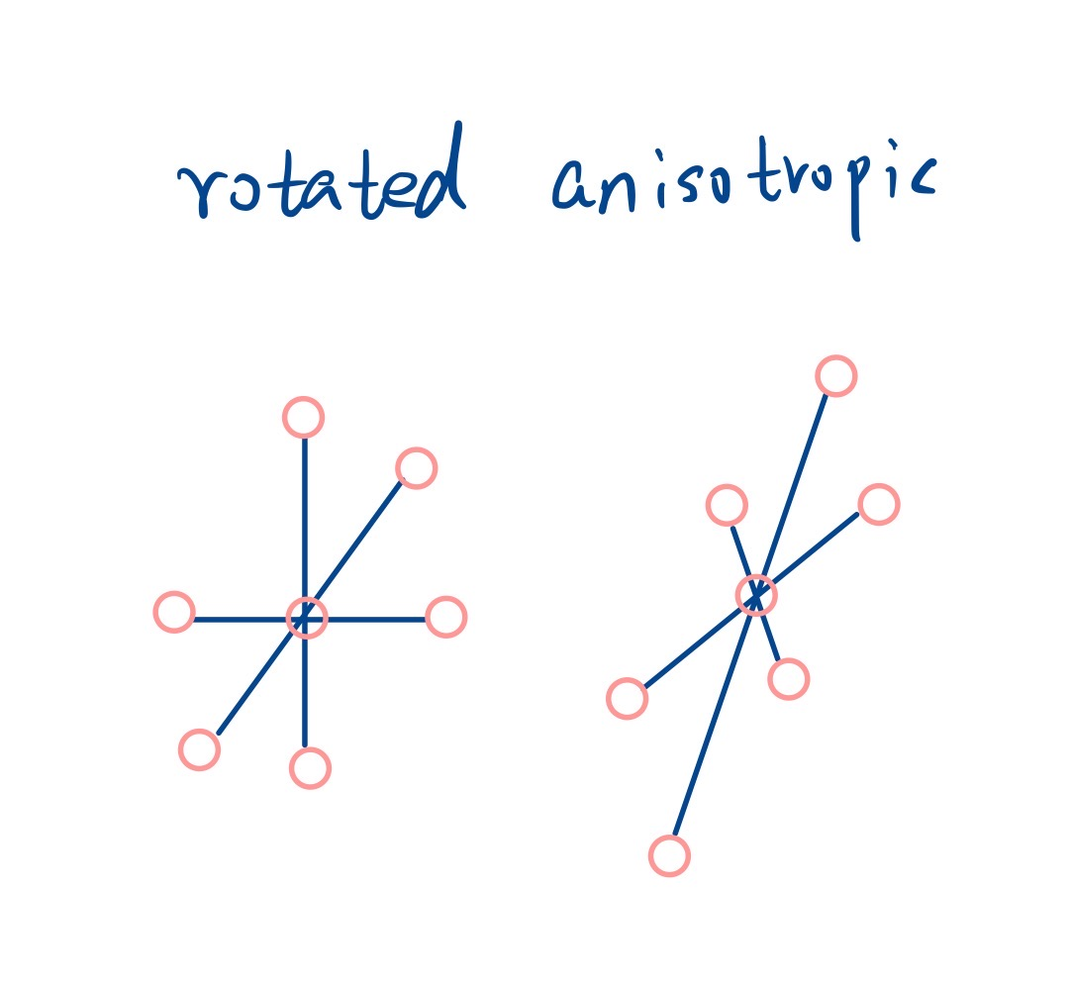
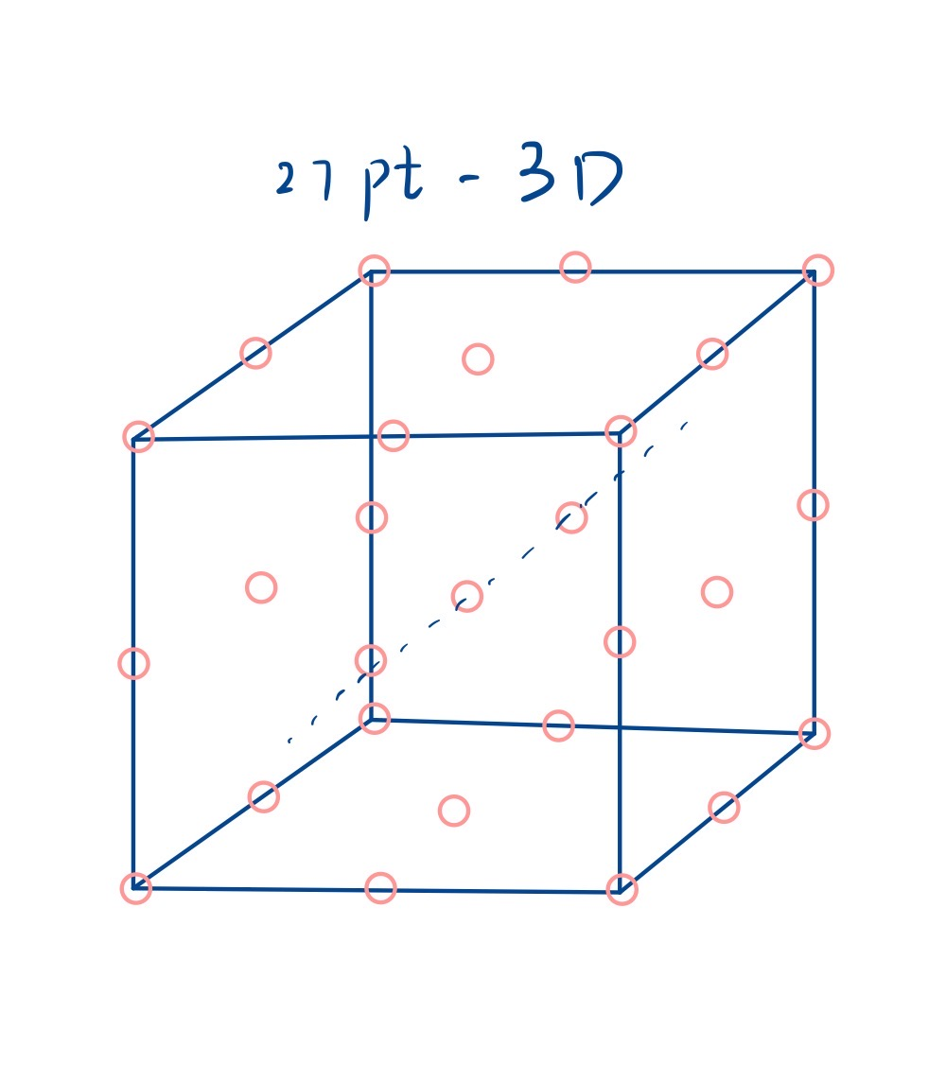
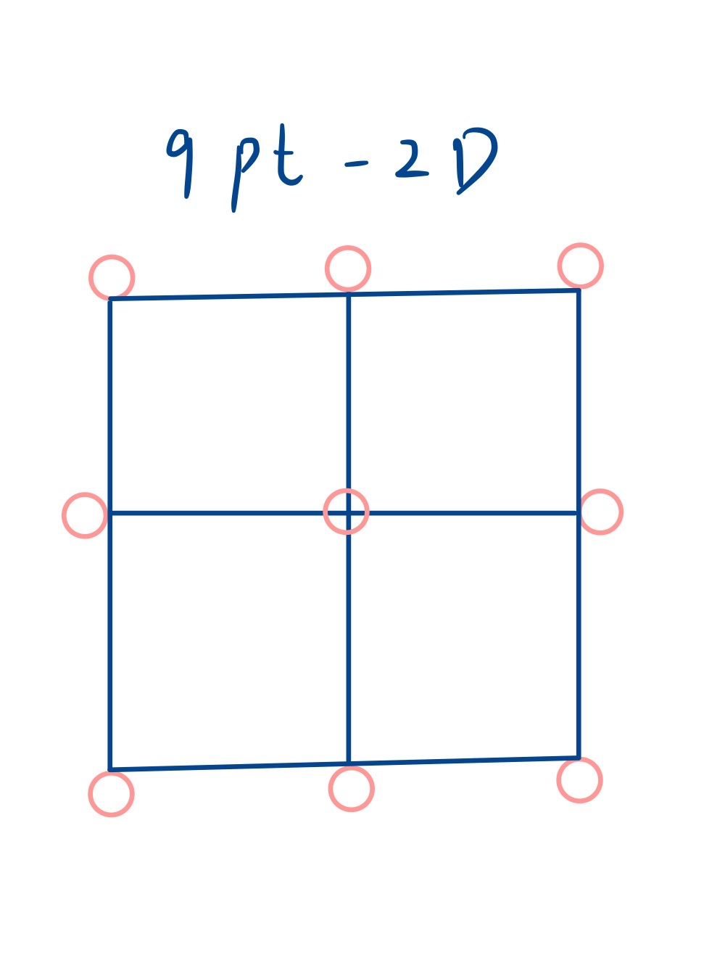
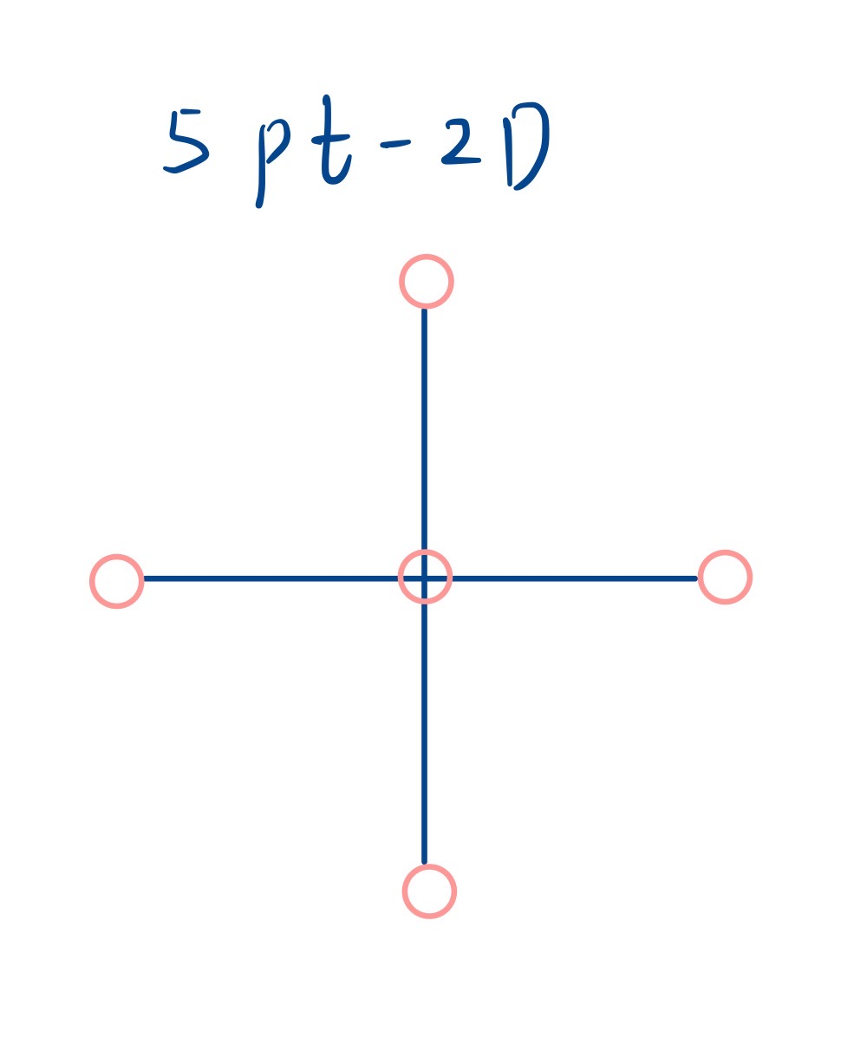
‹#› | APMA 4302 Final Project

Slide 18
Reference List
^{[1]} Christoph Klein, Robert Strzodka. Preconditioning Sparse Matrices with Alternating and Multiplicative Operator Splittings. SIAM J. Sci. Comput. Vol. 45, No. 1, pp. A25-A48. 2023.
‹#› | APMA 4302 Final Project

